Slide 1
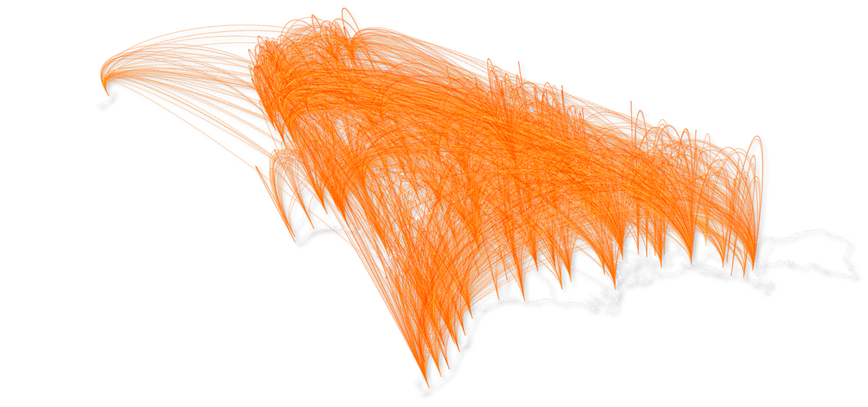


Collective models
Goal: generate/predict mobility flows between origins and destinations
Examples:
Commuting flows
Migration/relocation flows
https://www.flaticon.com/authors/dave-gandy

Slide 2
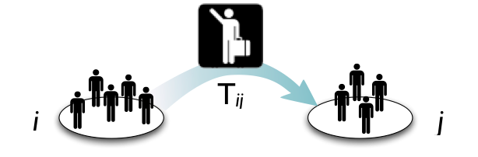
Spatial flows and OD matrices
Mathematically, spatial flows are represented as a Origin-Destination (OD) matrix, T:
Define locations discretizing space, using a tessellation (e.g., counties, municipalities)
Element T_{ij} is the number of trips from i to j per unit time.
New York City, NY
Boston, MA

Slide 3
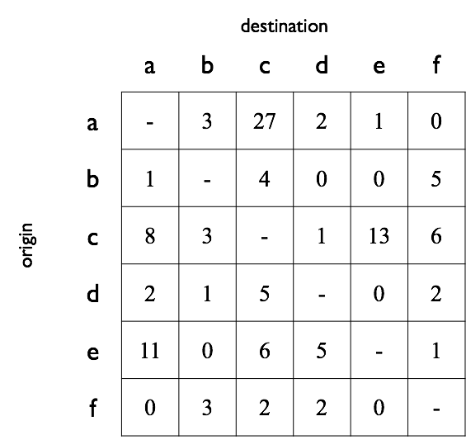



OD matrix
Total out-flow from i
Total in-flow to j
Total flow
(self-loops are usually not considered)

Slide 4
Probabilistic models of spatial flows
The model assigns a probability to each possible OD-matrix T
Methods to fit the model’s parameters
maximizing the likelihood of observed T*
minimizing the distance from observed T*

Slide 5
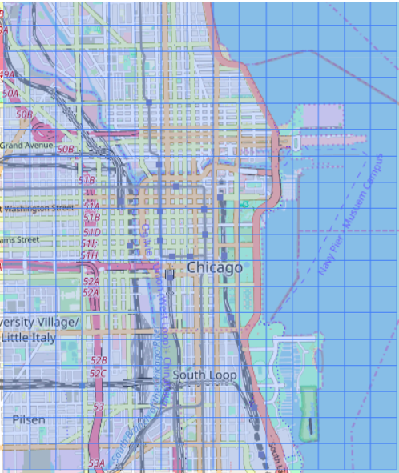
Idea: Interpret the problem as a classification task
classes = locations
Probabilistic models of spatial flows

Slide 6
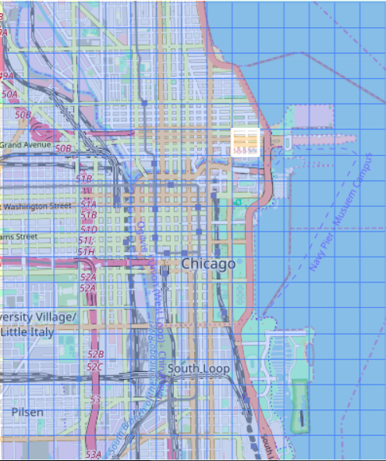
Idea: Interpret the problem as a classification task
given a trip’s origin location, predict the destination
Probabilistic models of spatial flows

Slide 7
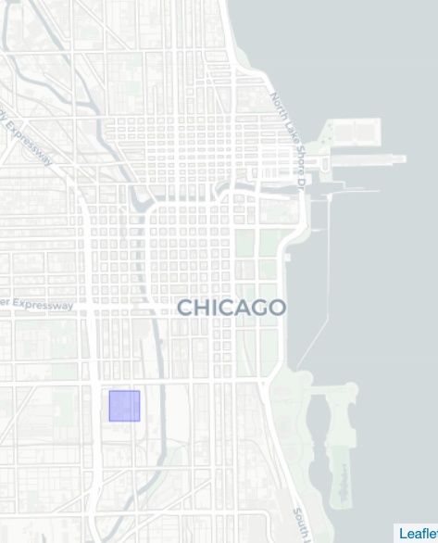
Goal: find the correct class ( = location of destination)
Each location has some probability to be the destination
How do we estimate these probabilities?
Probabilistic models of spatial flows

Slide 8

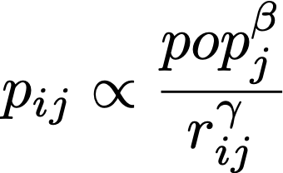
Flows decay with distance
Flows grow with population
The probability to observe a trip between i and j is large
probability
Gravity model

Slide 9
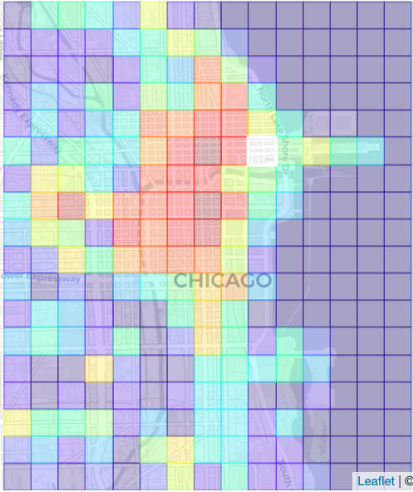
Parameters β and y can be estimated using maximum likelihood
probability
Gravity model

Slide 10

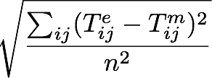
Validation of collective models
Comprehensive survey on distance/similarity measures between probability density functions. (Cha, S. H., 2007, City, 1(2))
Common metrics to compare OD matrices
Sorensen-Dice similarity (Common part of commuters)
Root Mean Squared Error
More (cosine similarity, correlation, …)

